Slide 1
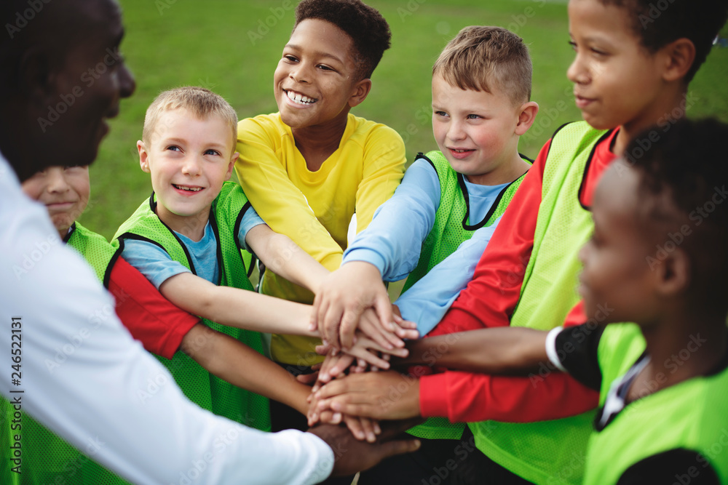
PE
PE at Ellistown ensures that children have a varied and well mapped out PE curriculum. It
provides the opportunity for progression across the full breadth of the PE National Curriculum
for KS1 and KS2 for both indoor and outdoor PE. ​
This progression is clearly identified on our progression maps and each lesson has been carefully
planned to match these. In KS1, the focus of the PE curriculum is on the development of the
fundamental skills that will be built upon in KS2 when they are applied in specific sports. At
Ellistown, it is our intention to develop a lifelong love of physical activity, sport and PE in all
young people. We aim to help ensure a positive and healthy physical and mental outlook in the
future and help our pupils to develop essential skills like leadership and teamwork. ​
Within each lesson, we strive to give every child the opportunity to develop skills in PE, consider
the impact on their health and fitness, compete/perform and evaluate. These elements are
always clearly identified both in lesson plans and on progression maps. All lessons are carefully considered to
ensure that learning is as tailored and inclusive as possible.
Please note, EYFS have one hour of PE lessons a week along with one hour of physical development within the learning environment
 | Unit 1 | Unit 2 | Unit 3 | Unit 4 | Unit 5 | Unit 6
EYFS | Big Moves | Dance: Dinosaurs | Best Of Balls | Dance: Dance till you drop | Gymnastics: Jumping Jacks | Games: The Olympics
Year 1 | Multi-Skills: Throwing and Catching​ ​Gymnastics: Animals | Invasion Games: At the Fair​ Dance: Starry Skies | Attacking & Defending Circuit Training | Multi-skills: Bat and Ball​ Dance: The Seasons | Multi-skills: Running and Jumping​ ​Gymnastics: Traditional Tales | Multi-Skills: Sports Day​ Yoga
Year 2 | Multi-Skills: Throwing and Catching​ Gymnastics: Landscapes and Cities | Invasion Games Dance: Gunpowder Plot | Attacking & Defending​ Circuit Training | Multi-skills: Bat and Ball​ Dance: Plants | Multi-skills: Target Games Gymnastics: Under the Sea | Animal Olympics​ Dance: Toys
Year 3 | OAA​ Gymnastics: Movement | Invasion Games; Fundamentals Dodgeball | Invasion Games: Football​ Circuit Training | Net and Wall Games: Fundamentals​ Dance: Rainforest Dance | Striking and Fielding Games: Fundamentals​ Gymnastics: Shape​ | Athletics​ ​Dance: Extreme Earth
Year 4 | OAA​ Gymnastics: Movement​ | Invasion Games:​​ Dance: Romans | Invasion Games; Tag Rugby or Hockey​​ Circuit Training | Net and Wall Games: Badminton Dance: Carnival of the animals | Striking and Fielding Games: Cricket​ Gymnastics: Shape & Balance-Ancient Egypt | Athletics​ ​Dance: Water
Year 5 | OAA​ Gymnastics: Movement | Invasion Games:​ Dance: World War 2 | Invasion Games: Basketball​ Circuit Training | Net and Wall Games: Tennis​ Gymnastics: Shape & Balance-Space | Striking and Fielding Games: Rounders​ Dance-Eco Earth | Athletics Invasion Games: Handball
Year 6 | OAA Gymnastics- Movement | Invasion Games Dance: Electricity | Invasion Games: Netball Circuit Training | Net and Wall Games: Volleyball Gymnastics: Rivers and Mountains | Striking and Fielding Games Dance Through the Decades | Athletics​ Leadership in PE

Slide 2
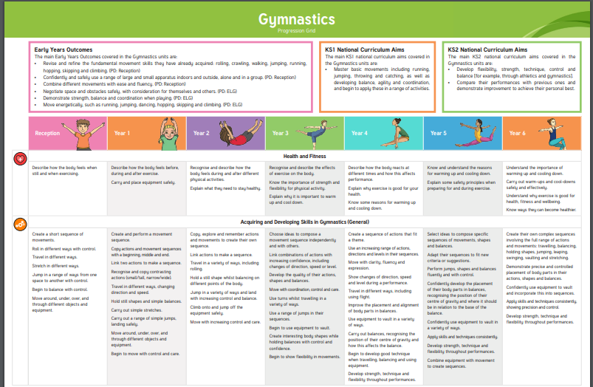
Progression in Gymnastics

Slide 3
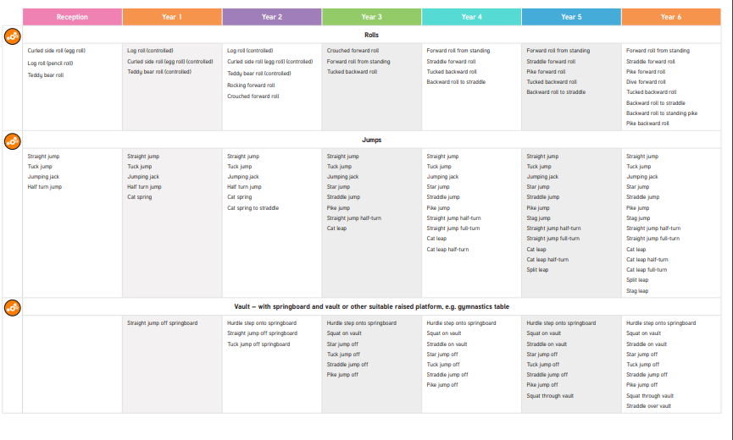

Slide 4
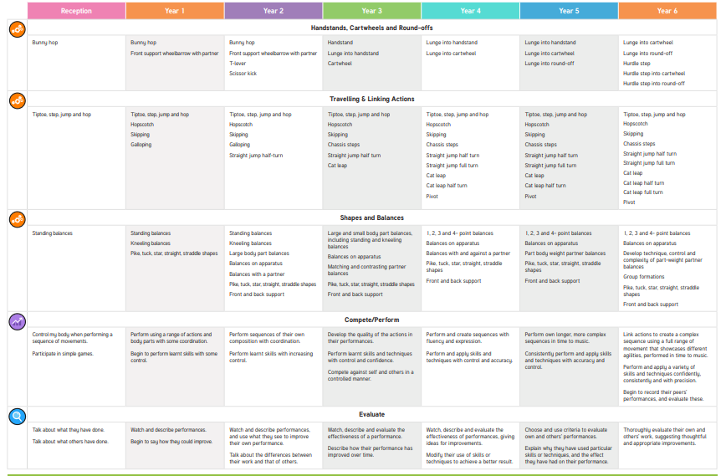

Slide 5
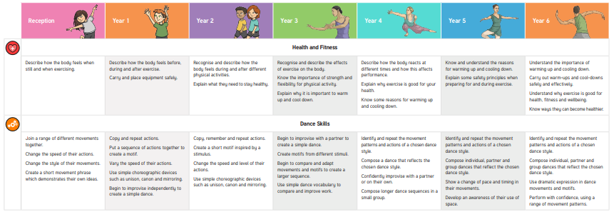
PE Progression - dance

Slide 6
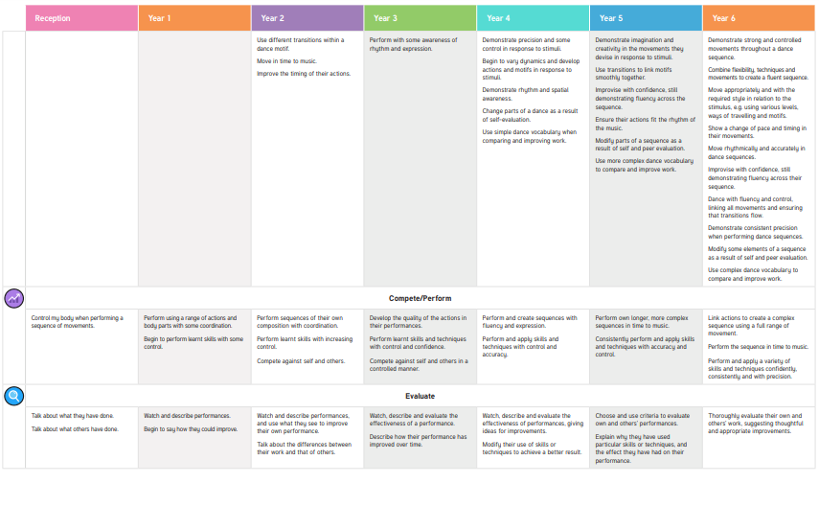

Slide 7
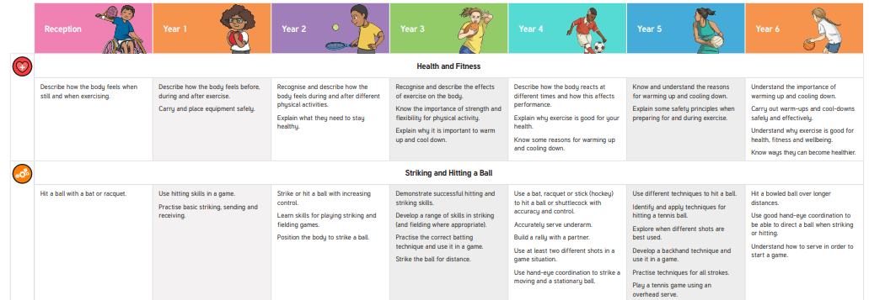
Pe Progression- Games

Slide 8
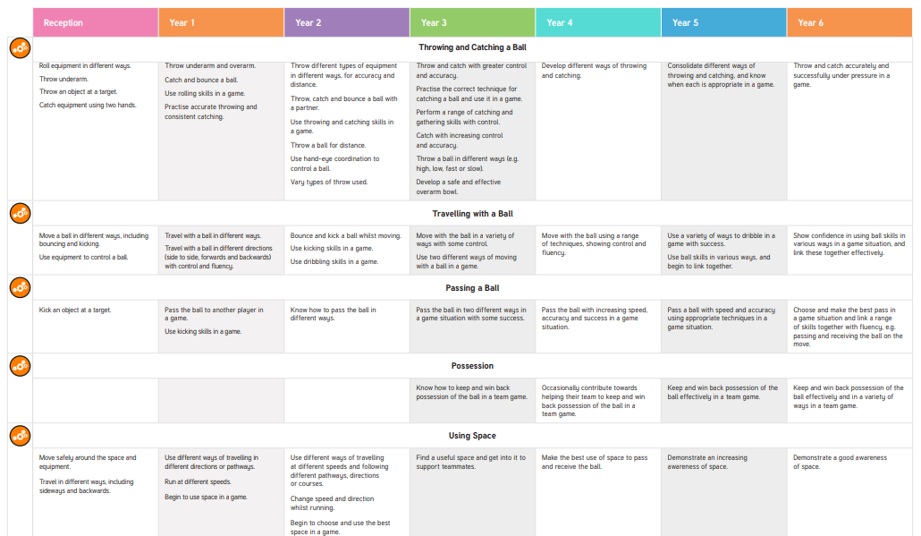

Slide 9
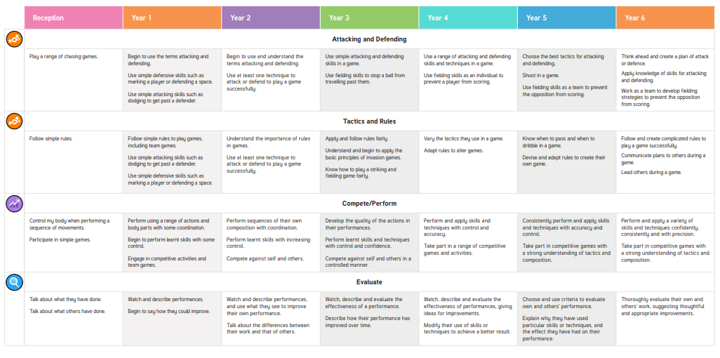

Slide 10
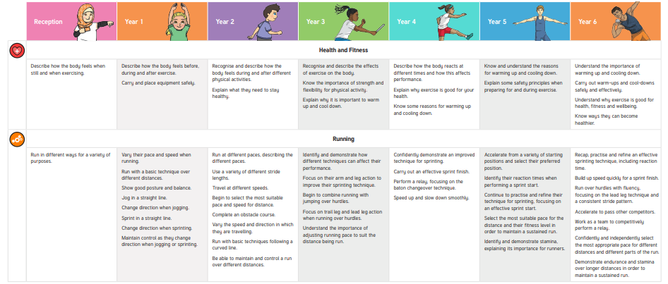
PE Progression- Athletics

Slide 11
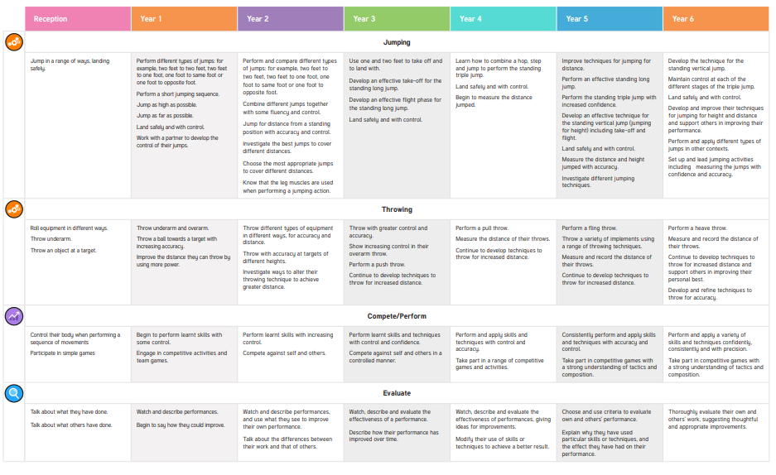

Slide 12

PE Progression- Outdoor Adventurous Activity

Slide 13
